Slide 1
CISC versus RISC
CISC | RISC
Emphasis on hardware | Emphasis on software
Includes multi-clock complex instructions | Single-clock, reduced instruction only
Memory-to-memory: "LOAD" and "STORE" incorporated in instructions | Register to register: "LOAD" and "STORE" are independent instructions
Small code sizes, high cycles per second | Low cycles per second, large code sizes
Transistors used for storing complex instructions | Spends more transistors on memory registers

Slide 2
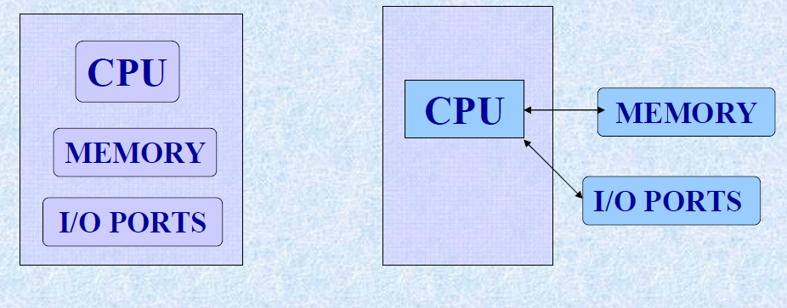
Microprocessor and microcontroller
Micro Controller
It is a single chip Consists Memory, I/o ports
Micro Processor
It is a CPU
Memory, I/O Ports to be connected externally

Slide 3
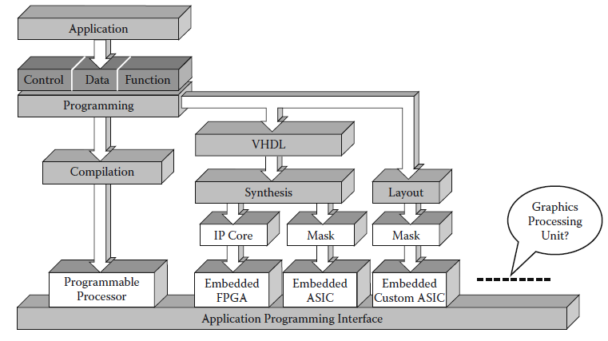
Computers Design: Hybrid Technologies

Slide 4
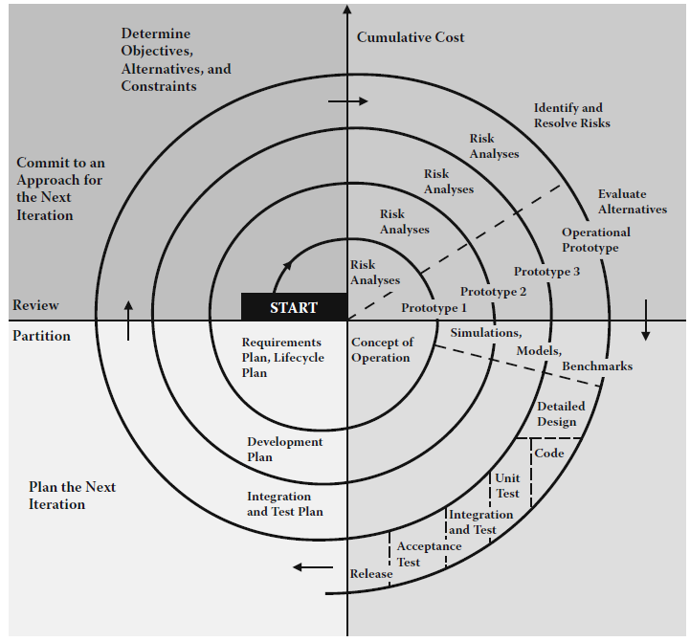
Computers: Developm’t Process/Managem’t Perspectives

Slide 5
Micro-architectures

Slide 6
Topics
Introduction
Assembly Language
Machine Language
Programming
Addressing Modes

Slide 7
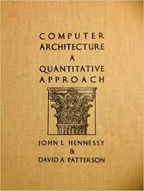

Slide 8
Introduction
Jumping up a few levels of abstraction.
Architecture: the programmer’s view of the computer
Defined by instructions (operations) and operand locations
Microarchitecture: how to implement an architecture in hardware

Slide 9

John Hennessy
President of Stanford University
Professor of Electrical Engineering and Computer Science at Stanford since 1977
Coinvented the Reduced Instruction Set Computer (RISC)
Developed the MIPS architecture at Stanford in 1984 and cofounded MIPS Computer Systems
As of 2004, over 300 million MIPS microprocessors have been sold

Slide 10
Architecture Design Principles
Underlying design principles, as articulated by Hennessy and Patterson:
Simplicity favors regularity
Make the common case fast
Smaller is faster
Good design demands good compromises

Slide 11
Instructions: Addition
add: mnemonic indicates what operation to perform
b, c: source operands on which the operation is performed
a: destination operand to which the result is written
High-level code
a = b + c;
MIPS assembly code
add a, b, c

Slide 12
Instructions: Subtraction
Subtraction is similar to addition. Only the mnemonic changes.
sub: mnemonic indicates what operation to perform
b, c: source operands on which the operation is performed
a: destination operand to which the result is written
High-level code
a = b - c;
MIPS assembly code
sub a, b, c

Slide 13
Design Principle 1
Simplicity favors regularity
Consistent instruction format
Same number of operands (two sources and one destination)
easier to encode and handle in hardware

Slide 14
Instructions: More Complex Code
More complex code is handled by multiple MIPS instructions.
High-level code
a = b + c - d;
// single line comment
/* multiple line
comment */
MIPS assembly code
add t, b, c # t = b + c
sub a, t, d # a = t - d

Slide 15
Design Principle 2
Make the common case fast
MIPS includes only simple, commonly used instructions.
Hardware to decode and execute the instruction can be simple, small, and fast.
More complex instructions (that are less common) can be performed using multiple simple instructions.
MIPS is a reduced instruction set computer (RISC), with a small number of simple instructions.
Other architectures, such as Intel’s IA-32 found in many PC’s, are complex instruction set computers (CISC). They include complex instructions that are rarely used, such as the “string move” instruction that copies a string (a series of characters) from one part of memory to another.

Slide 16
Operands
A computer needs a physical location from which to retrieve binary operands
A computer retrieves operands from:
Registers
Memory
Constants (also called immediates)

Slide 17
Operands: Registers
Memory is slow.
Most architectures have a small set of (fast) registers.
MIPS has thirty-two 32-bit registers.
MIPS is called a 32-bit architecture because it operates on 32-bit data.
(A 64-bit version of MIPS also exists, but we will consider only the 32-bit version.)

Slide 18
Design Principle 3
Smaller is Faster
MIPS includes only a small number of registers
Just as retrieving data from a few books on your table is faster than sorting through 1000 books, retrieving data from 32 registers is faster than retrieving it from 1000 registers or a large memory.

Slide 19
The MIPS Register Set
Name | Register Number | Usage
$0 | 0 | the constant value 0
$at | 1 | assembler temporary
$v0-$v1 | 2-3 | procedure return values
$a0-$a3 | 4-7 | procedure arguments
$t0-$t7 | 8-15 | temporaries
$s0-$s7 | 16-23 | saved variables
$t8-$t9 | 24-25 | more temporaries
$k0-$k1 | 26-27 | OS temporaries
$gp | 28 | global pointer
$sp | 29 | stack pointer
$fp | 30 | frame pointer
$ra | 31 | procedure return address

Slide 20
Operands: Registers
Registers:
Written with a dollar sign ($) before their name
For example, register 0 is written “$0”, pronounced “register zero” or “dollar zero”.
Certain registers used for specific purposes:
For example,
$0 always holds the constant value 0.
the saved registers, $s0-$s7, are used to hold variables
the temporary registers, $t0 - $t9, are used to hold intermediate values during a larger computation.
For now, we only use the temporary registers ($t0 - $t9) and the saved registers ($s0 - $s7).
We will use the other registers in later slides.

Slide 21
Instructions with registers
Revisit add instruction
High-level code
a = b + c
MIPS assembly code
# $s0 = a, $s1 = b, $s2 = c
add $s0, $s1, $s2

Slide 22
Operands: Memory
Too much data to fit in only 32 registers
Store more data in memory
Memory is large, so it can hold a lot of data
But it’s also slow
Commonly used variables kept in registers
Using a combination of registers and memory, a program can access a large amount of data fairly quickly

Slide 23
Word-Addressable Memory
Each 32-bit data word has a unique address

Slide 24
Reading Word-Addressable Memory
Memory reads are called loads
Mnemonic: load word (lw)
Example: read a word of data at memory address 1 into $s3
Memory address calculation:
add the base address ($0) to the offset (1)
address = ($0 + 1) = 1
Any register may be used to store the base address.
$s3 holds the value 0xF2F1AC07 after the instruction completes.
Assembly code
lw $s3, 1($0) # read memory word 1 into $s3

Slide 25
Writing Word-Addressable Memory
Memory writes are called stores
Mnemonic: store word (sw)
Example: Write (store) the value held in $t4 into memory address 7
Offset can be written in decimal (default) or hexadecimal
Memory address calculation:
add the base address ($0) to the offset (0x7)
address: ($0 + 0x7) = 7
Any register may be used to store the base address
Assembly code
sw $t4, 0x7($0) # write the value in $t4
# to memory word 7

Slide 26
Byte-Addressable Memory
Each data byte has a unique address
Load/store words or single bytes: load byte (lb) and store byte (sb)
Each 32-bit words has 4 bytes, so the word address increments by 4

Slide 27
Reading Byte-Addressable Memory
The address of a memory word must now be multiplied by 4. For example,
the address of memory word 2 is 2 × 4 = 8
the address of memory word 10 is 10 × 4 = 40 (0x28)
Load a word of data at memory address 4 into $s3.
$s3 holds the value 0xF2F1AC07 after the instruction completes.
MIPS is byte-addressed, not word-addressed
MIPS assembly code
lw $s3, 4($0) # read word at address 4 into $s3

Slide 28
Writing Byte-Addressable Memory
Example: stores the value held in $t7 into memory address 0x2C (44)
MIPS assembly code
sw $t7, 44($0) # write $t7 into address 44

Slide 29
Big-Endian and Little-Endian Memory
How to number bytes within a word?
Word address is the same for big- or little-endian
Little-endian: byte numbers start at the little (least significant) end
Big-endian: byte numbers start at the big (most significant) end

Slide 30
Big- and Little-Endian Example
Suppose $t0 initially contains 0x23456789. After the following program is run on a big-endian system, what value does $s0 contain? In a little-endian system?
sw $t0, 0($0)
lb $s0, 1($0)

Slide 31
Big- and Little-Endian Example
Suppose $t0 initially contains 0x23456789. After the following program is run on a big-endian system, what value does $s0 contain? In a little-endian system?
sw $t0, 0($0)
lb $s0, 1($0)
Big-endian: 0x00000045
Little-endian: 0x00000067

Slide 32
Design Principle 4
Good design demands good compromises
Multiple instruction formats allow flexibility
add, sub: use 3 register operands
lw, sw: use 2 register operands and a constant
Number of instruction formats kept small
to adhere to design principles 1 and 3 (simplicity favors regularity and smaller is faster).

Slide 33
Operands: Constants/Immediates
lw and sw illustrate the use of constants or immediates
Called immediates because they are immediately available from the instruction
Immediates don’t require a register or memory access.
The add immediate (addi) instruction adds an immediate to a variable (held in a register).
An immediate is a 16-bit two’s complement number.
Is subtract immediate (subi) necessary?
High-level code
a = a + 4;
b = a – 12;
MIPS assembly code
# $s0 = a, $s1 = b
addi $s0, $s0, 4
addi $s1, $s0, -12

Slide 34
Machine Language
Computers only understand 1’s and 0’s
Machine language: binary representation of instructions
32-bit instructions
Again, simplicity favors regularity: 32-bit data and instructions
Three instruction formats:
R-Type: register operands
I-Type: immediate operand
J-Type: for jumping

Slide 35
R-Type
Register-type
3 register operands:
rs, rt: source registers
rd: destination register
Other fields:
op: the operation code or opcode (0 for R-type instructions)
funct: the function
together, the opcode and function tell the computer
what operation to perform
shamt: the shift amount for shift instructions, otherwise it’s 0

Slide 36
R-Type Examples
Note the order of registers in the assembly code:
add rd, rs, rt

Slide 37
I-Type
Immediate-type
3 operands:
rs, rt: register operands
imm: 16-bit two’s complement immediate
Other fields:
op: the opcode
Simplicity favors regularity: all instructions have opcode
Operation is completely determined by the opcode

Slide 38
I-Type Examples
Note the differing order of registers in the assembly and machine codes:
addi rt, rs, imm
lw rt, imm(rs)
sw rt, imm(rs)

Slide 39
Machine Language: J-Type
Jump-type
26-bit address operand (addr)
Used for jump instructions (j)

Slide 40
Review: Instruction Formats

Slide 41
The Power of the Stored Program
32-bit instructions and data stored in memory
Sequence of instructions: only difference between two applications (for example, a text editor and a video game)
To run a new program:
No rewiring required
Simply store new program in memory
The processor hardware executes the program:
fetches (reads) the instructions from memory in sequence
performs the specified operation
The program counter (PC) keeps track of the current instruction
In MIPS, programs typically start at memory address 0x00400000

Slide 42
The Stored Program

Slide 43
Interpreting Machine Language Code
Start with opcode
Opcode tells how to parse the remaining bits
If opcode is all 0’s
R-type instruction
Function bits tell what instruction it is
Otherwise
opcode tells what instruction it is

Slide 44
Programming
High-level languages:
e.g., C, Java, Python
Written at more abstract level
Common high-level software constructs:
if/else statements
for loops
while loops
array accesses
procedure calls
Other useful instructions:
Arithmetic/logical instructions
Branching

Slide 45
Logical Instructions
and, or, xor, nor
and: useful for masking bits
Masking all but the least significant byte of a value:
0xF234012F AND 0x000000FF = 0x0000002F
or: useful for combining bit fields
Combine 0xF2340000 with 0x000012BC:
0xF2340000 OR 0x000012BC = 0xF23412BC
nor: useful for inverting bits:
A NOR $0 = NOT A
andi, ori, xori
16-bit immediate is zero-extended (not sign-extended)
nori not needed

Slide 46
Logical Instruction Examples

Slide 47
Logical Instruction Examples

Slide 48
Logical Instruction Examples

Slide 49
Logical Instruction Examples

Slide 50
Shift Instructions
sll: shift left logical
Example: sll $t0, $t1, 5 # $t0 <= $t1 << 5
srl: shift right logical
Example: srl $t0, $t1, 5 # $t0 <= $t1 >> 5
sra: shift right arithmetic
Example: sra $t0, $t1, 5 # $t0 <= $t1 >>> 5
Variable shift instructions:
sllv: shift left logical variable
Example: sllv $t0, $t1, $t2 # $t0 <= $t1 << $t2
srlv: shift right logical variable
Example: srlv $t0, $t1, $t2 # $t0 <= $t1 >> $t2
srav: shift right arithmetic variable
Example: srav $t0, $t1, $t2 # $t0 <= $t1 >>> $t2

Slide 51
Shift Instructions

Slide 52
Generating Constants
16-bit constants using addi:
32-bit constants using load upper immediate (lui) and ori:
(lui loads the 16-bit immediate into the upper half of the register and sets the lower half to 0.)
High-level code
// int is a 32-bit signed word
int a = 0x4f3c;
MIPS assembly code
# $s0 = a
addi $s0, $0, 0x4f3c
High-level code
int a = 0xFEDC8765;
MIPS assembly code
# $s0 = a
lui $s0, 0xFEDC
ori $s0, $s0, 0x8765

Slide 53
Multiplication, Division
Special registers: lo, hi
32 × 32 multiplication, 64 bit result
mult $s0, $s1
Result in {hi, lo}
32-bit division, 32-bit quotient, 32-bit remainder
div $s0, $s1
Quotient in lo
Remainder in hi
Moves from lo/hi special registers
mflo $s2
mfhi $s3

Slide 54
Branching
Allows a program to execute instructions out of sequence.
Types of branches:
Conditional branches
branch if equal (beq)
branch if not equal (bne)
Unconditional branches
jump (j)
jump register (jr)
jump and link (jal)

Slide 55
Review: The Stored Program

Slide 56
Conditional Branching (beq)
# MIPS assembly
addi $s0, $0, 4 # $s0 = 0 + 4 = 4
addi $s1, $0, 1 # $s1 = 0 + 1 = 1
sll $s1, $s1, 2 # $s1 = 1 << 2 = 4
beq $s0, $s1, target # branch is taken
addi $s1, $s1, 1 # not executed
sub $s1, $s1, $s0 # not executed
target: # label
add $s1, $s1, $s0 # $s1 = 4 + 4 = 8
Labels indicate instruction locations in a program. They cannot use reserved words and must be followed by a colon (:).

Slide 57
The Branch Not Taken (bne)
# MIPS assembly
addi $s0, $0, 4 # $s0 = 0 + 4 = 4
addi $s1, $0, 1 # $s1 = 0 + 1 = 1
sll $s1, $s1, 2 # $s1 = 1 << 2 = 4
bne $s0, $s1, target # branch not taken
addi $s1, $s1, 1 # $s1 = 4 + 1 = 5
sub $s1, $s1, $s0 # $s1 = 5 – 4 = 1
target:
add $s1, $s1, $s0 # $s1 = 1 + 4 = 5

Slide 58
Unconditional Branching / Jumping (j)
# MIPS assembly
addi $s0, $0, 4 # $s0 = 4
addi $s1, $0, 1 # $s1 = 1
j target # jump to target
sra $s1, $s1, 2 # not executed
addi $s1, $s1, 1 # not executed
sub $s1, $s1, $s0 # not executed
target:
add $s1, $s1, $s0 # $s1 = 1 + 4 = 5

Slide 59
Unconditional Branching (jr)
# MIPS assembly
0x00002000 addi $s0, $0, 0x2010
0x00002004 jr $s0
0x00002008 addi $s1, $0, 1
0x0000200C sra $s1, $s1, 2
0x00002010 lw $s3, 44($s1)

Slide 60
High-Level Code Constructs
if statements
if/else statements
while loops
for loops

Slide 61
If Statement
High-level code
if (i == j)
f = g + h;
f = f – i;
MIPS assembly code
# $s0 = f, $s1 = g, $s2 = h
# $s3 = i, $s4 = j

Slide 62
If Statement
High-level code
if (i == j)
f = g + h;
f = f – i;
MIPS assembly code
# $s0 = f, $s1 = g, $s2 = h
# $s3 = i, $s4 = j
bne $s3, $s4, L1
add $s0, $s1, $s2
L1: sub $s0, $s0, $s3
Notice that the assembly tests for the opposite case (i != j) than the test in the high-level code (i == j).

Slide 63
If / Else Statement
High-level code
if (i == j)
f = g + h;
else
f = f – i;
MIPS assembly code
# $s0 = f, $s1 = g, $s2 = h
# $s3 = i, $s4 = j

Slide 64
If / Else Statement
High-level code
if (i == j)
f = g + h;
else
f = f – i;
MIPS assembly code
# $s0 = f, $s1 = g, $s2 = h
# $s3 = i, $s4 = j
bne $s3, $s4, L1
add $s0, $s1, $s2
j done
L1: sub $s0, $s0, $s3
done:

Slide 65
While Loops
High-level code
// determines the power
// of x such that 2^{x} = 128
int pow = 1;
int x = 0;
while (pow != 128) {
pow = pow * 2;
x = x + 1;
}
MIPS assembly code
# $s0 = pow, $s1 = x

Slide 66
While Loops
High-level code
// determines the power
// of x such that 2^{x} = 128
int pow = 1;
int x = 0;
while (pow != 128) {
pow = pow * 2;
x = x + 1;
}
MIPS assembly code
# $s0 = pow, $s1 = x
addi $s0, $0, 1
add $s1, $0, $0
addi $t0, $0, 128
while: beq $s0, $t0, done
sll $s0, $s0, 1
addi $s1, $s1, 1
j while
done:
Notice that the assembly tests for the opposite case (pow == 128) than the test in the high-level code (pow != 128).

Slide 67
For Loops
The general form of a for loop is:
for (initialization; condition; loop operation)
loop body
initialization: executes before the loop begins
condition: is tested at the beginning of each iteration
loop operation: executes at the end of each iteration
loop body: executes each time the condition is met

Slide 68
For Loops
High-level code
// add the numbers from 0 to 9
int sum = 0;
int i;
for (i=0; i!=10; i = i+1) {
sum = sum + i;
}
MIPS assembly code
# $s0 = i, $s1 = sum

Slide 69
For Loops
High-level code
// add the numbers from 0 to 9
int sum = 0;
int i;
for (i=0; i!=10; i = i+1) {
sum = sum + i;
}
MIPS assembly code
# $s0 = i, $s1 = sum
addi $s1, $0, 0
add $s0, $0, $0
addi $t0, $0, 10
for: beq $s0, $t0, done
add $s1, $s1, $s0
addi $s0, $s0, 1
j for
done:
Notice that the assembly tests for the opposite case (i == 128) than the test in the high-level code (i != 10).

Slide 70
Less Than Comparisons
High-level code
// add the powers of 2 from 1
// to 100
int sum = 0;
int i;
for (i=1; i < 101; i = i*2) {
sum = sum + i;
}
MIPS assembly code
# $s0 = i, $s1 = sum

Slide 71
Less Than Comparisons
High-level code
// add the powers of 2 from 1
// to 100
int sum = 0;
int i;
for (i=1; i < 101; i = i*2) {
sum = sum + i;
}
MIPS assembly code
# $s0 = i, $s1 = sum
addi $s1, $0, 0
addi $s0, $0, 1
addi $t0, $0, 101
loop: slt $t1, $s0, $t0
beq $t1, $0, done
add $s1, $s1, $s0
sll $s0, $s0, 1
j loop
done:
$t1 = 1 if i < 101.

Slide 72
Arrays
Useful for accessing large amounts of similar data
Array element: accessed by index
Array size: number of elements in the array

Slide 73
Arrays
5-element array
Base address = 0x12348000 (address of the first array element, array[0])
First step in accessing an array: load base address into a register

Slide 74
Arrays
// high-level code
int array[5];
array[0] = array[0] * 2;
array[1] = array[1] * 2;
# MIPS assembly code
# array base address = $s0

Slide 75
Arrays
// high-level code
int array[5];
array[0] = array[0] * 2;
array[1] = array[1] * 2;
# MIPS assembly code
# array base address = $s0
lui $s0, 0x1234 # put 0x1234 in upper half of $S0
ori $s0, $s0, 0x8000 # put 0x8000 in lower half of $s0
lw $t1, 0($s0) # $t1 = array[0]
sll $t1, $t1, 1 # $t1 = $t1 * 2
sw $t1, 0($s0) # array[0] = $t1
lw $t1, 4($s0) # $t1 = array[1]
sll $t1, $t1, 1 # $t1 = $t1 * 2
sw $t1, 4($s0) # array[1] = $t1

Slide 76
Arrays Using For Loops
// high-level code
int array[1000];
int i;
for (i=0; i < 1000; i = i + 1)
array[i] = array[i] * 8;
# MIPS assembly code
# $s0 = array base address, $s1 = i

Slide 77
Arrays Using For Loops
# MIPS assembly code
# $s0 = array base address, $s1 = i
# initialization code
lui $s0, 0x23B8 # $s0 = 0x23B80000
ori $s0, $s0, 0xF000 # $s0 = 0x23B8F000
addi $s1, $0, 0 # i = 0
addi $t2, $0, 1000 # $t2 = 1000
loop:
slt $t0, $s1, $t2 # i < 1000?
beq $t0, $0, done # if not then done
sll $t0, $s1, 2 # $t0 = i * 4 (byte offset)
add $t0, $t0, $s0 # address of array[i]
lw $t1, 0($t0) # $t1 = array[i]
sll $t1, $t1, 3 # $t1 = array[i] * 8
sw $t1, 0($t0) # array[i] = array[i] * 8
addi $s1, $s1, 1 # i = i + 1
j loop # repeat
done:

Slide 78
ASCII Codes
American Standard Code for Information Interchange
assigns each text character a unique byte value
For example, S = 0x53, a = 0x61, A = 0x41
Lower-case and upper-case letters differ by 0x20 (32).

Slide 79
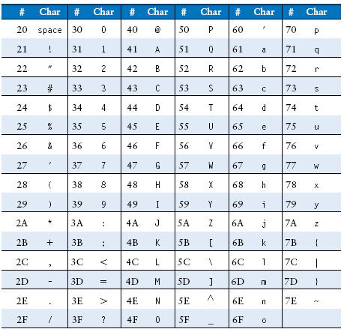
Cast of Characters

Slide 80
Procedure Calls
Definitions
Caller: calling procedure (in this case, main)
Callee: called procedure (in this case, sum)
High-level code
void main()
{
int y;
y = sum(42, 7);
...
}
int sum(int a, int b)
{
return (a + b);
}

Slide 81
Procedure Calls
Procedure calling conventions:
Caller:
passes arguments to callee.
jumps to the callee
Callee:
performs the procedure
returns the result to caller
returns to the point of call
must not overwrite registers or memory needed by the caller
MIPS conventions:
Call procedure: jump and link (jal)
Return from procedure: jump register (jr)
Argument values: $a0 - $a3
Return value: $v0

Slide 82
Procedure Calls
High-level code
int main() {
simple();
a = b + c;
}
void simple() {
return;
}
MIPS assembly code
0x00400200 main: jal simple
0x00400204 add $s0, $s1, $s2
...
0x00401020 simple: jr $ra
void means that simple doesn’t return a value.

Slide 83
Procedure Calls
High-level code
int main() {
simple();
a = b + c;
}
void simple() {
return;
}
MIPS assembly code
0x00400200 main: jal simple
0x00400204 add $s0, $s1, $s2
...
0x00401020 simple: jr $ra
jal: jumps to simple and saves PC+4 in the return address register ($ra).
In this case, $ra = 0x00400204 after jal executes.
jr $ra: jumps to address in $ra, in this case 0x00400204.

Slide 84
Input Arguments and Return Values
MIPS conventions:
Argument values: $a0 - $a3
Return value: $v0

Slide 85
Input Arguments and Return Values
High-level code
int main()
{
int y;
...
y = diffofsums(2, 3, 4, 5); // 4 arguments
...
}
int diffofsums(int f, int g, int h, int i)
{
int result;
result = (f + g) - (h + i);
return result; // return value
}

Slide 86
Input Arguments and Return Values
MIPS assembly code
# $s0 = y
main:
...
addi $a0, $0, 2 # argument 0 = 2
addi $a1, $0, 3 # argument 1 = 3
addi $a2, $0, 4 # argument 2 = 4
addi $a3, $0, 5 # argument 3 = 5
jal diffofsums # call procedure
add $s0, $v0, $0 # y = returned value
...
# $s0 = result
diffofsums:
add $t0, $a0, $a1 # $t0 = f + g
add $t1, $a2, $a3 # $t1 = h + i
sub $s0, $t0, $t1 # result = (f + g) - (h + i)
add $v0, $s0, $0 # put return value in $v0
jr $ra # return to caller

Slide 87
Input Arguments and Return Values
MIPS assembly code
# $s0 = result
diffofsums:
add $t0, $a0, $a1 # $t0 = f + g
add $t1, $a2, $a3 # $t1 = h + i
sub $s0, $t0, $t1 # result = (f + g) - (h + i)
add $v0, $s0, $0 # put return value in $v0
jr $ra # return to caller
diffofsums overwrote 3 registers: $t0, $t1, and $s0
diffofsums can use the stack to temporarily store registers

Slide 88
The Stack
Memory used to temporarily save variables
Like a stack of dishes, last-in-first-out (LIFO) queue
Expands: uses more memory when more space is needed
Contracts: uses less memory when the space is no longer needed

Slide 89
The Stack
Grows down (from higher to lower memory addresses)
Stack pointer: $sp, points to top of the stack

Slide 90
How Procedures use the Stack
Called procedures must have no other unintended side effects.
But diffofsums overwrites 3 registers: $t0, $t1, $s0
# MIPS assembly
# $s0 = result
diffofsums:
add $t0, $a0, $a1 # $t0 = f + g
add $t1, $a2, $a3 # $t1 = h + i
sub $s0, $t0, $t1 # result = (f + g) - (h + i)
add $v0, $s0, $0 # put return value in $v0
jr $ra # return to caller

Slide 91
Storing Register Values on the Stack
# $s0 = result
diffofsums:
addi $sp, $sp, -12 # make space on stack
# to store 3 registers
sw $s0, 8($sp) # save $s0 on stack
sw $t0, 4($sp) # save $t0 on stack
sw $t1, 0($sp) # save $t1 on stack
add $t0, $a0, $a1 # $t0 = f + g
add $t1, $a2, $a3 # $t1 = h + i
sub $s0, $t0, $t1 # result = (f + g) - (h + i)
add $v0, $s0, $0 # put return value in $v0
lw $t1, 0($sp) # restore $t1 from stack
lw $t0, 4($sp) # restore $t0 from stack
lw $s0, 8($sp) # restore $s0 from stack
addi $sp, $sp, 12 # deallocate stack space
jr $ra # return to caller

Slide 92
The Stack during diffofsums Call

Slide 93
Registers
Preserved Callee-Saved | Nonpreserved Caller-Saved
$s0 - $s7 | $t0 - $t9
$ra | $a0 - $a3
$sp | $v0 - $v1
stack above $sp | stack below $sp

Slide 94
Multiple Procedure Calls
proc1:
addi $sp, $sp, -4 # make space on stack
sw $ra, 0($sp) # save $ra on stack
jal proc2
...
lw $ra, 0($sp) # restore $s0 from stack
addi $sp, $sp, 4 # deallocate stack space
jr $ra # return to caller

Slide 95
Storing Saved Registers on the Stack
# $s0 = result
diffofsums:
addi $sp, $sp, -4 # make space on stack to
# store one register
sw $s0, 0($sp) # save $s0 on stack
# no need to save $t0 or $t1
add $t0, $a0, $a1 # $t0 = f + g
add $t1, $a2, $a3 # $t1 = h + i
sub $s0, $t0, $t1 # result = (f + g) - (h + i)
add $v0, $s0, $0 # put return value in $v0
lw $s0, 0($sp) # restore $s0 from stack
addi $sp, $sp, 4 # deallocate stack space
jr $ra # return to caller

Slide 96
Recursive Procedure Call
High-level code
int factorial(int n) {
if (n <= 1)
return 1;
else
return (n * factorial(n-1));
}

Slide 97
Recursive Procedure Call
MIPS assembly code

Slide 98
Recursive Procedure Call
MIPS assembly code
0x90 factorial: addi $sp, $sp, -8 # make room
0x94 sw $a0, 4($sp) # store $a0
0x98 sw $ra, 0($sp) # store $ra
0x9C addi $t0, $0, 2
0xA0 slt $t0, $a0, $t0 # a <= 1 ?
0xA4 beq $t0, $0, else # no: go to else
0xA8 addi $v0, $0, 1 # yes: return 1
0xAC addi $sp, $sp, 8 # restore $sp
0xB0 jr $ra # return
0xB4 else: addi $a0, $a0, -1 # n = n - 1
0xB8 jal factorial # recursive call
0xBC lw $ra, 0($sp) # restore $ra
0xC0 lw $a0, 4($sp) # restore $a0
0xC4 addi $sp, $sp, 8 # restore $sp
0xC8 mul $v0, $a0, $v0 # n * factorial(n-1)
0xCC jr $ra # return

Slide 99
Stack during Recursive Call

Slide 100
Procedure Call Summary
Caller
Put arguments in $a0-$a3
Save any registers that are needed ($ra, maybe $t0-t9)
jal callee
Restore registers
Look for result in $v0
Callee
Save registers that might be disturbed ($s0-$s7)
Perform procedure
Put result in $v0
Restore registers
jr $ra

Slide 101
Addressing Modes
How do we address the operands?
Register Only
Immediate
Base Addressing
PC-Relative
Pseudo Direct

Slide 102
Addressing Modes
Register Only Addressing
Operands found in registers
Example: add $s0, $t2, $t3
Example: sub $t8, $s1, $0
Immediate Addressing
16-bit immediate used as an operand
Example: addi $s4, $t5, -73
Example: ori $t3, $t7, 0xFF

Slide 103
Addressing Modes
Base Addressing
Address of operand is:
base address + sign-extended immediate
Example: lw $s4, 72($0)
Address = $0 + 72
Example: sw $t2, -25($t1)
Address = $t1 - 25

Slide 104
Addressing Modes
PC-Relative Addressing
0x10 beq $t0, $0, else
0x14 addi $v0, $0, 1
0x18 addi $sp, $sp, i
0x1C jr $ra
0x20 else: addi $a0, $a0, -1
0x24 jal factorial

Slide 105
Addressing Modes
Pseudo-direct Addressing
0x0040005C jal sum
...
0x004000A0 sum: add $v0, $a0, $a1

Slide 106
How do we compile & run an application?

Slide 107
What needs to be stored in memory?
Instructions (also called text)
Data
Global/static: allocated before program begins
Dynamic: allocated within program
How big is memory?
At most 2³² = 4 gigabytes (4 GB)
From address 0x00000000 to 0xFFFFFFFF

Slide 108
The MIPS Memory Map

Slide 109
Example Program: C Code
int f, g, y; // global variables
int main(void)
{
f = 2;
g = 3;
y = sum(f, g);
return y;
}
int sum(int a, int b) {
return (a + b);
}

Slide 110
Example Program: Assembly Code
.data
f:
g:
y:
.text
main:
addi $sp, $sp, -4 # stack frame
sw $ra, 0($sp) # store $ra
addi $a0, $0, 2 # $a0 = 2
sw $a0, f # f = 2
addi $a1, $0, 3 # $a1 = 3
sw $a1, g # g = 3
jal sum # call sum
sw $v0, y # y = sum()
lw $ra, 0($sp) # restore $ra
addi $sp, $sp, 4 # restore $sp
jr $ra # return to OS
sum:
add $v0, $a0, $a1 # $v0 = a + b
jr $ra # return
int f, g, y; // global
int main(void)
{
f = 2;
g = 3;
y = sum(f, g);
return y;
}
int sum(int a, int b) {
return (a + b);
}

Slide 111
Example Program: Symbol Table
Symbol | Address

Slide 112
Example Program: Symbol Table
Symbol | Address
f | 0x10000000
g | 0x10000004
y | 0x10000008
main | 0x00400000
sum | 0x0040002C

Slide 113
Example Program: Executable

Slide 114
Example Program: In Memory

Slide 115
Odds and Ends
Pseudoinstructions
Exceptions
Signed and unsigned instructions
Floating-point instructions

Slide 116
Pseudoinstruction Examples
Pseudoinstruction | MIPS Instructions
li $s0, 0x1234AA77 | lui $s0, 0x1234 ori $s0, 0xAA77
mul $s0, $s1, $s2 | mult $s1, $s2 mflo $s0
clear $t0 | add $t0, $0, $0
move $s1, $s2 | add $s2, $s1, $0
nop | sll $0, $0, 0

Slide 117
Exceptions
Unscheduled procedure call to the exception handler
Casued by:
Hardware, also called an interrupt, e.g. keyboard
Software, also called traps, e.g. undefined instruction
When exception occurs, the processor:
Records the cause of the exception
Jumps to the exception handler at instruction address 0x80000180
Returns to program

Slide 118
Exception Registers
Not part of the register file.
Cause
Records the cause of the exception
EPC (Exception PC)
Records the PC where the exception occurred
EPC and Cause: part of Coprocessor 0
Move from Coprocessor 0
mfc0 $t0, EPC
Moves the contents of EPC into $t0

Slide 119
Exception Causes
Exception | Cause
Hardware Interrupt | 0x00000000
System Call | 0x00000020
Breakpoint / Divide by 0 | 0x00000024
Undefined Instruction | 0x00000028
Arithmetic Overflow | 0x00000030

Slide 120
Exceptions
Processor saves cause and exception PC in Cause and EPC
Processor jumps to exception handler (0x80000180)
Exception handler:
Saves registers on stack
Reads the Cause register
mfc0 $t0, Cause
Handles the exception
Restores registers
Returns to program
mfc0 $k0, EPC
jr $k0

Slide 121
Signed and Unsigned Instructions
Addition and subtraction
Multiplication and division
Set less than

Slide 122
Addition and Subtraction
Signed: add, addi, sub
Same operation as unsigned versions
But processor takes exception on overflow
Unsigned: addu, addiu, subu
Doesn’t take exception on overflow
Note: addiu sign-extends the immediate

Slide 123
Multiplication and Division
Signed: mult, div
Unsigned: multu, divu

Slide 124
Set Less Than
Signed: slt, slti
Unsigned: sltu, sltiu
Note: sltiu sign-extends the immediate before comparing it to the register

Slide 125
Loads
Signed:
Sign-extends to create 32-bit value to load into register
Load halfword: lh
Load byte: lb
Unsigned: addu, addiu, subu
Zero-extends to create 32-bit value
Load halfword unsigned: lhu
Load byte: lbu

Slide 126
Floating-Point Instructions
Floating-point coprocessor (Coprocessor 1)
32 32-bit floating-point registers ($f0 - $f31)
Double-precision values held in two floating point registers
e.g., $f0 and $f1, $f2 and $f3, etc.
So, double-precision floating point registers: $f0, $f2, $f4, etc.

Slide 127
Floating-Point Instructions
Name | Register Number |  | Usage
$fv0 - $fv1 |  | 0, 2 | return values
$ft0 - $ft3 |  | 4, 6, 8, 10 | temporary variables
$fa0 - $fa1 |  | 12, 14 | procedure arguments
$ft4 - $ft8 |  | 16, 18 | temporary variables
$fs0 - $fs5 |  | 20, 22, 24, 26, 28, 30 | saved variables

Slide 128
F-Type Instruction Format
Opcode = 17 (010001₂)
Single-precision:
cop = 16 (010000₂)
add.s, sub.s, div.s, neg.s, abs.s, etc.
Double-precision:
cop = 17 (010001₂)
add.d, sub.d, div.d, neg.d, abs.d, etc.
3 register operands:
fs, ft: source operands
fd: destination operands

Slide 129
Floating-Point Branches
Set/clear condition flag: fpcond
Equality: c.seq.s, c.seq.d
Less than: c.lt.s, c.lt.d
Less than or equal: c.le.s, c.le.d
Conditional branch
bclf: branches if fpcond is FALSE
bclt: branches if fpcond is TRUE
Loads and stores
lwc1: lwc1 $ft1, 42($s1)
swc1: swc1 $fs2, 17($sp)

